Slide 1


EV Charging Station Booking System
Problem Statement
To design and implement a system to manage multiple EV charging stations, handle slot bookings fairly, and allow users to find nearest available stations.
Introduction
This project demonstrates an EV Charging Station network . It uses a queue-based to manage vehicle bookings fairly, ensuring a "first-in, first-out" process for available slots. The system allows users to find available stations by city
Team Details
THAI RISHI SARAN DATTA– PES2UG24CS560
UDAYESWAR SEERAMA– PES2UG24CS516
SRIKANTH V REDDY– PES2UG24CS519

Slide 2






Data Structures Used & Reason
Linear data structure
Non-Linear
Queue (Array-Based)
Array of Structs
Graphs
Used for: The `bookingqueue` inside each `Station` struct. Reason: Ensures a First-In, First-Out (FIFO) process. This is the fairest method to manage vehicle bookings for a limited number of charging slots.
Used for: The primary container `Station stations[MAX]` to hold all station objects. Reason: Provides simple, O(1) time complexity for accessing any station object using its ID (which corresponds to the array index).
Used for: Ajdacency matrix[MAX][MAX]` to represent the network of stations. Also to find nearest station(BFS) Reason: Chosen to map connections between stations. Future scope includes using BFS for a true "nearest station" search.

Slide 3
Queue (for Booking System)
Operation | Description | Algorithm Summary
initqueue(q) | Initializes a new empty queue. | Sets front and rear to -1.
isFull(q) | Checks if the queue has reached max capacity. | Returns true if rear == MAX - 1.
isEmpty(q) | Checks if the queue has no elements. | Returns true if front == -1.
enqueue(q, val) | Adds a vehicleID to the rear of the queue. | Increments rear, adds val to items[rear]. Handles front initialization if it's the first element.
dequeue(q) | Removes a vehicleID from the front of the queue. | Gets val from items[front], increments front. Resets queue if front > rear.

Slide 4
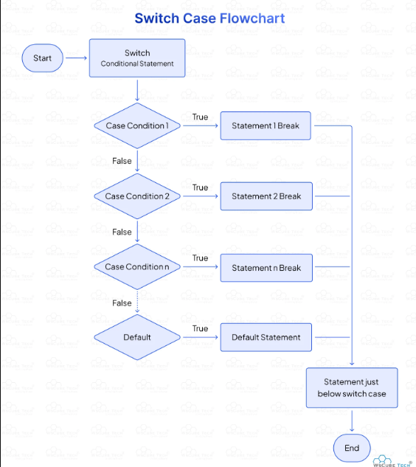

Implemented Functionalities (1/2)
Adding & Displaying Stations
The system provides functions to build and monitor the station network:
loadDefaultStations(): Automatically called at startup to populate the system with 5 initial stations across 3 cities for testing.
addStation() (Option 1): Allows the user to manually add a new station, specifying its name, city, and total slot capacity .Also user should enter city that he want to connect a new city
displayStations() (Option 5): Shows a complete, formatted list of all added stations, their details, and the current number of vehicles in their booking queue.

Slide 5

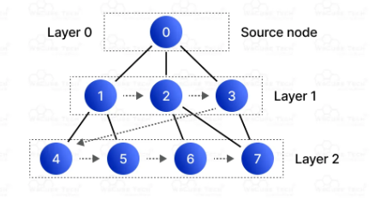
Implemented Functionalities (2/2)
Booking & Finding Stations
Core user interactions are handled by these functions:
bookSlot() (Option 2): A user provides a Station ID and a Vehicle ID. The system then enqueues the vehicle at that station.
cancelBooking() (Option 3): A user provides a Station ID. The system dequeues the vehicle from the front of that station's queue, respecting the FIFO order.
findneareststation() (Option 4): The user enters a city name. The system searches it by using breadth first search(BFS) algorithm which we use in graphs(non-linear) and display near stations based on availability.

Slide 6
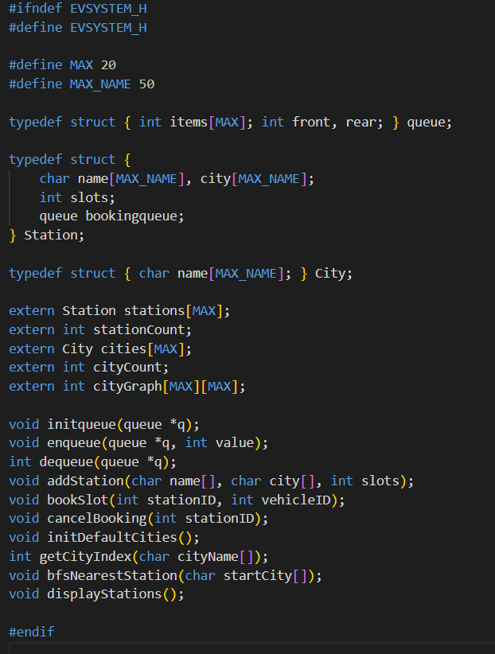
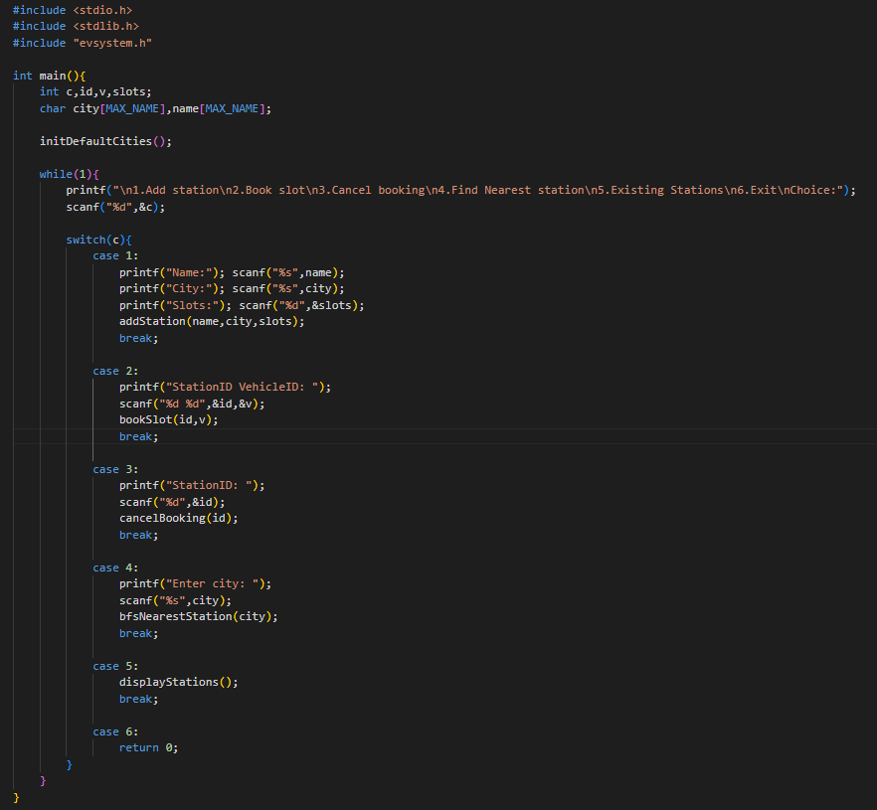
Code screenshots

Slide 7
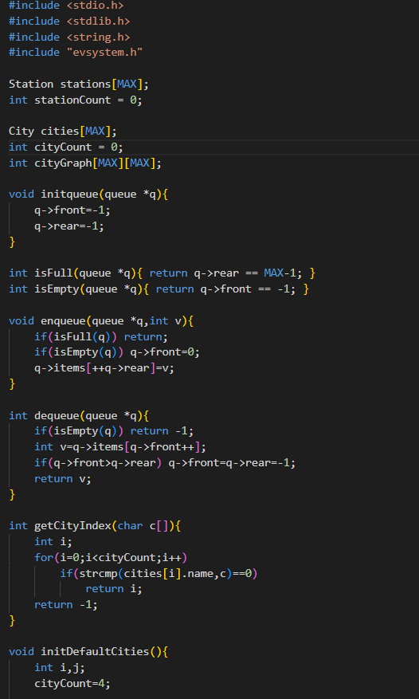
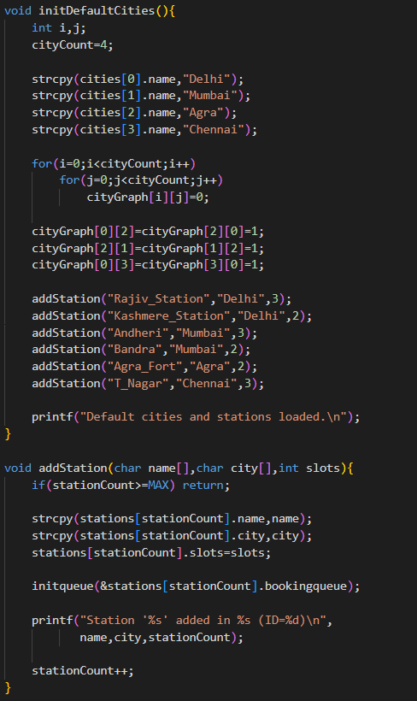

Slide 8
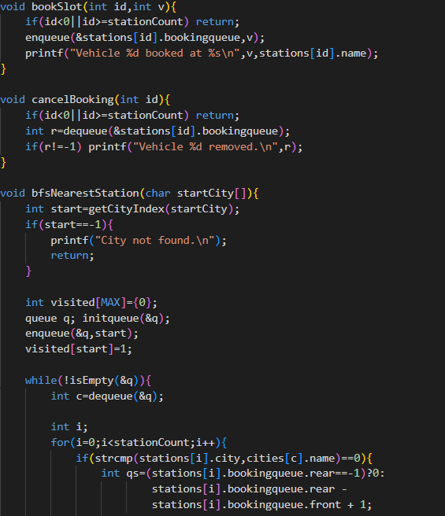
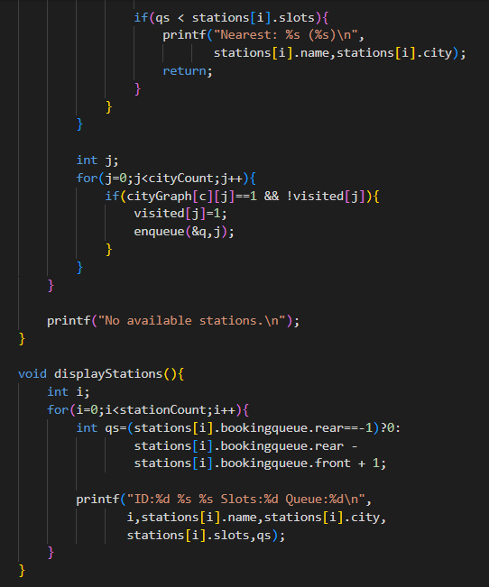

Slide 9
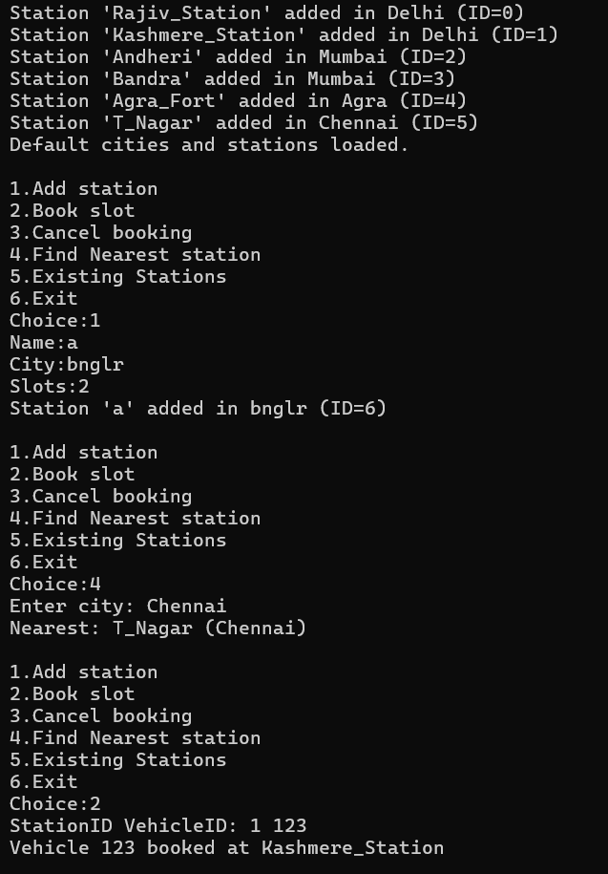
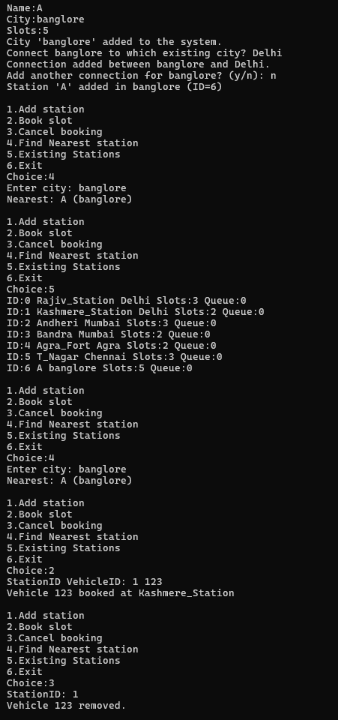
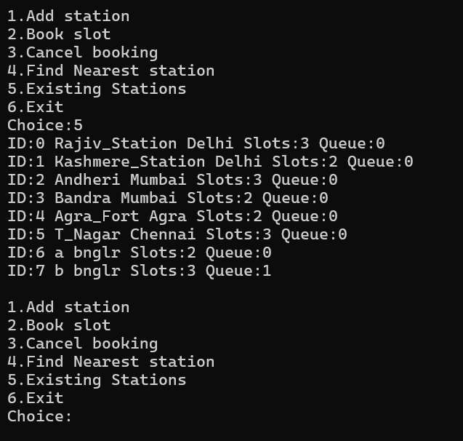
output

Slide 10


Conclusion & Team Work
Concluding Remarks
Division of Work
This project successfully implements a core booking system for EV charging stations using data structures
MEMBER 1-Implemented findNearestStationByCity and displayStations (Search & Display logic).
The system efficiently manages multiple stations and ensures a fair, FIFO booking process.
MEMBER 2- Developed the core Queue (enqueue/dequeue) and the bookSlot & cancelBooking functionalities.
The array-of-structs design allows for easy expansion.
Future enhancements could include implementing the initialized graph for a true BFS "nearest station" feature, rather than just a city-based search.
MEMBER 3-Designed Station struct, , main function and documentation.(PPT)

